Slide 1
The CANARI Rural Livelihood Programme: building community capacity, resilience and sustainability in local communities in Trinidad and Tobago
Session 1 : Community development and the environment
The First Biennial Community Development Partnership Forum & Exhibition (CDPF-1)
Hilton Hotel and Conference Centre, Port of Spain
Trinidad and Tobago
19 July, 2013

Slide 2

The Caribbean Natural Resources Institute
Mission: Promoting and facilitating equitable participation and effective collaboration in the management of natural resources critical to development in the Caribbean islands, so that people will have a better quality of life and natural resources will be conserved, through action learning and research, capacity building, communication and fostering partnerships

Slide 3
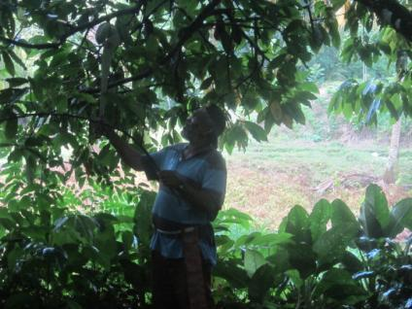
The Rural Livelihoods Programme
Programme goal: To support rural communities with the development of sustainable natural resource-based livelihoods through building capacity, catalysing partnerships and influencing policy to create an enabling institutional environment.
Credit: Aripo Youth Development Organization

Slide 4
Programme objectives
To conduct research on how to manage ecosystems to protect and enhance the provision of goods and services for sustainable and resilient livelihoods.
To develop and test a process for building the capacity of rural communities to develop sustainable small businesses based on the use of natural resources
To build the capacity of rural communities to develop sustainable livelihoods resilient to climate change and other risks, including via facilitating exchanges and sharing of information between rural communities

Slide 5
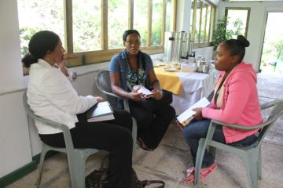
Programme objectives
To catalyse partnerships and build the capacity of partners to effectively support rural communities to develop sustainable livelihoods.
To communicate to influence policy for development of an enabling institutional environment that supports rural communities to develop sustainable livelihoods.

Slide 6
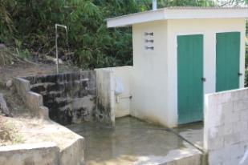
Foundation of the Programme
Observations:
Rural communities are often the most vulnerable
Many rural communities exist in poverty
Few livelihood opportunities exist
Natural and cultural resources provide best opportunities for development of sustainable livelihoods

Slide 7
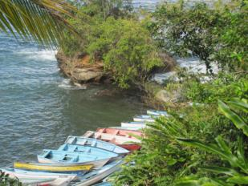
Foundation of the Programme
Challenges for communities:
Entrepreneurship and small business skills are often weak
People do not have legal access to the resources existing in the community
Business management and marketing is weak

Slide 8
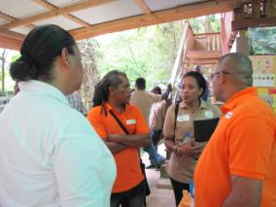
Foundation of the Programme
Other barriers:
Agencies that have a mandate to assist are not effectively reaching communities
People are unable to use available mechanisms to access support
Core communication and facilitation skills of agencies are lacking
Communities are unaware of support mechanisms or intimidated to seek support

Slide 9
Foundation of the Programme
CANARI developed a concept to assist these vulnerable groups
J.B. Fernandes Memorial Trust I has provided funding support to a project in 2010 that evolved into a programme of work in 2011.
The Programme is piloting an approach in Trinidad and Tobago with intention to replicate in other Caribbean islands.

Slide 10
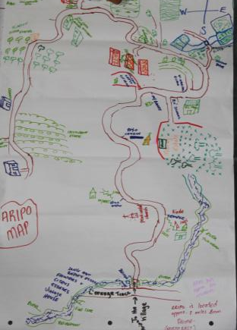
Activities
Phase 1 (2010-2011)
Assessment of natural resources in communities
Creating visions for the communities
Assessment of feasibility of businesses based on sustainable use of resources
Meeting the support agencies

Slide 11
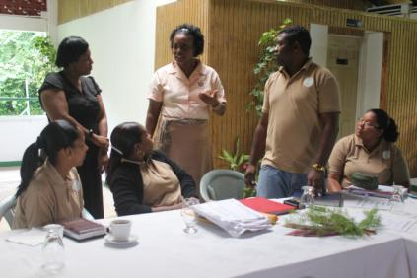
Activities (cont’d)
Phase 2 (2012-2013)
Development of business plans
Mentoring the groups developing businesses
Link with support agencies
Small grants programme
Communication, networking and marketing

Slide 12
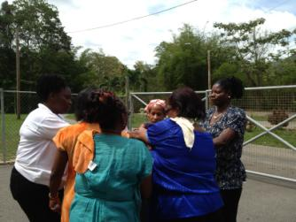
Other projects under the RLP
Current project under Programme funded by UN Women
Community Forestry project undertaken under FLG Programme
Participatory video: An advocacy tool to help the Blanchisseuse fishing community to communicate their challenges and develop partnerships to solve them

Slide 13
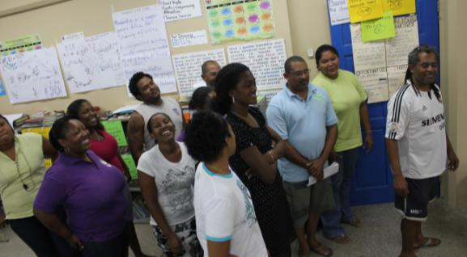
Tools used in the RLP
Capacity building, mentoring, action learning

Slide 14
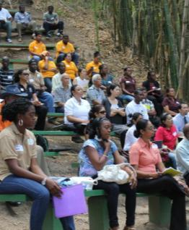
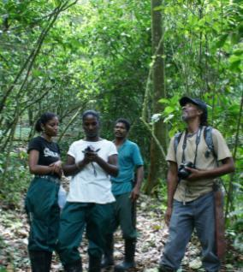
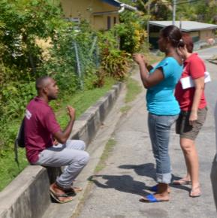
Tools used in the RLP
Community Expo, participatory video, participatory photojournalling, participatory mapping

Slide 15
Outcomes
Linkage with agencies: how to communicate
Linkage with each other: how to network
Establishment and development of businesses
Interest in training
Women in business (Blanchisseuse Aquaculture and Producers Association, Women Involved in Natural Resources )
Youth in business (Heights of Aripo)

Slide 16


Thank You
Caribbean Natural Resources Institute (CANARI)
Building 7, Fernandes Business Centre
Eastern Main Road, Laventille, Trinidad
Tel: 868-626-6062
Fax: 868-626-1788
E-mail: keisha@canari.org
Website: www.canari.org | : Caribbean Natural Resources Institute | : 2011CANARI
New: Check out CANARI publications on our Scribd page: Caribbean Natural Resources Institute

